Slide 1

Consumer Goods Ad_Hoc Insights

Slide 2
CONTENTS
01
02
Objectives
Problem Statemnet
03
04
Body
Conculsion
Here you could describe the topic of the section
Here you could describe the topic of the section
Here you could describe the topic of the section
Here you could describe the topic of the section

Slide 3
Objective
Atliq Hardwares are focused on increasing revenue by improving product strengths and creating in-demand products.
Atliq Hardwares are focused on increasing revenue by improving product strengths and creating in-demand products.
The Company seeks Insights for ad hoc requests.

Slide 4
Problem Statement
Atliq Hardware is a leading manufacturer of computer hardware in India and other nations, but it struggles to make prompt and wise choices based on data. The management intends to add more junior data analysts to the data analytics team. Tony Sharma, the head of data analytics, conducts a SQL challenge to identify applicants with both technical and soft skills.

Slide 5
Company Details
Atliq is a hardware company which manufactures and sells various electronic items such as personal computer’s/mouse/printers and sell to different customers such as Croma/Best Buy/Flipkart/Staples(Online Stores) which can further be bought by consumers.​
Atliq hardware follows September-August Fiscal year patter i.e. Fiscal year 2021 started in August 2020 and ended in September 2021 📅
Data-Driven Decision making: Data should be the key aspect in making various decisions for the business.​

Slide 6
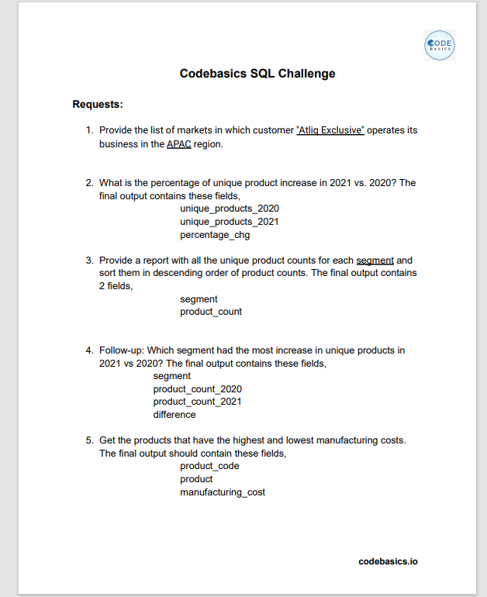
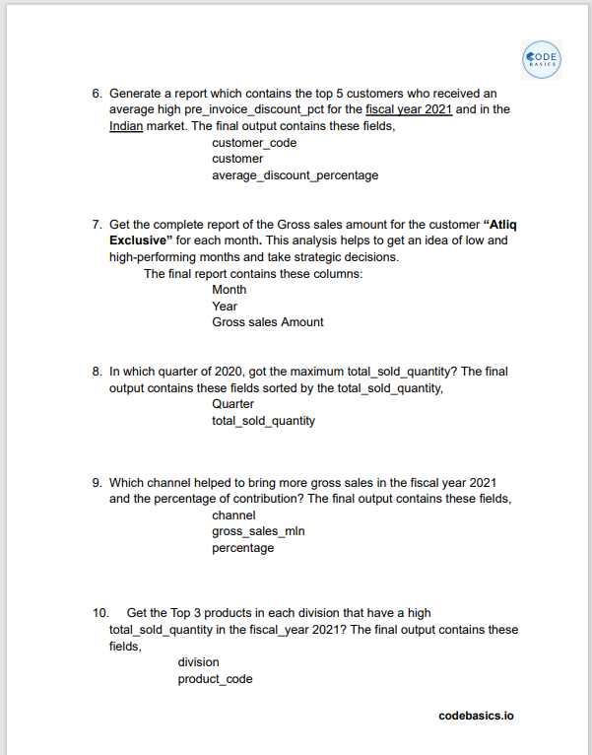
DATA & REQUESTS

Slide 7
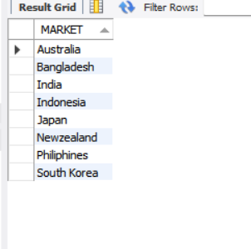
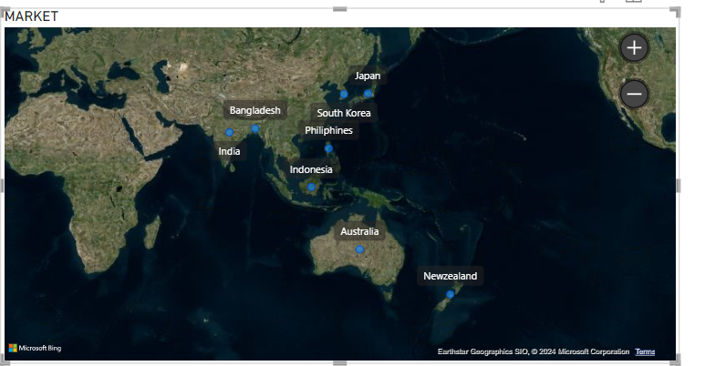
Provide the list of markets in which customer "Atliq Exclusive" operates its business in the APAC region.
SQL OUTPUT

Slide 8
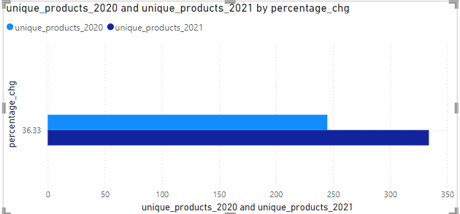
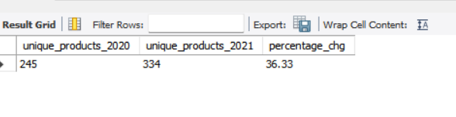
What is the percentage of unique product increase in 2021 vs. 2020? The final output contains these fields,
SQL OUTPUT
Percentage change is 36.33%
** Demand of product is increased

Slide 9
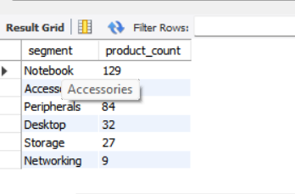
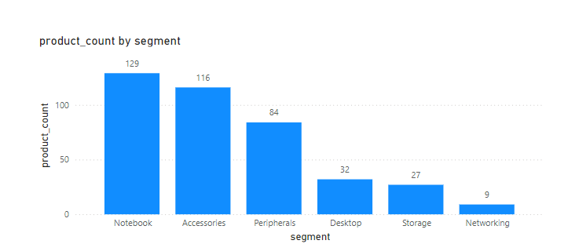
Provide a report with all the unique product counts for each segment and sort them in descending order of product counts.
SQL OUTPUT
Notebook is Manufacturing significantly more than others

Slide 10
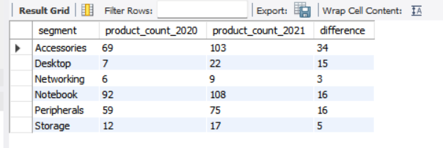
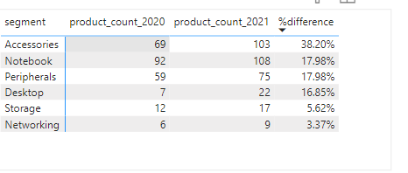
Which segment had the most increase in unique products in 2021 vs 2020?
SQL OUTPUT
Accessories is most increased product from 2020 to 2021

Slide 11
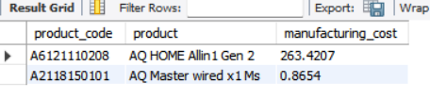
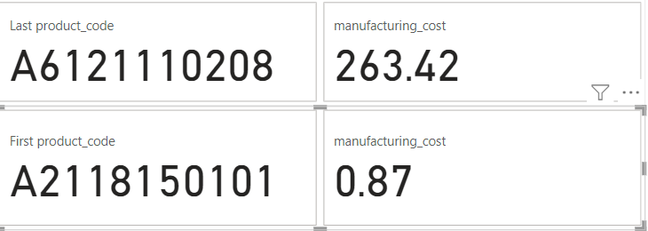
Get the products that have the highest and lowest manufacturing costs.
SQL OUTPUT
“AQ HOME Allin1 Gen 2” is highest manufacturing cost and “AQ Master wired x1 Ms” is lowest manufacturing cost

Slide 12
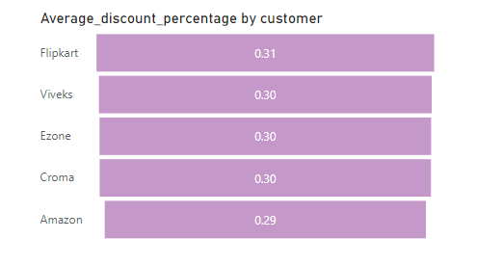
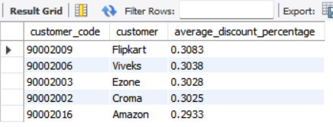
Generate a report which contains the top 5 customers who received an average high pre_invoice_discount_pct for the fiscal year 2021 and in the Indian market
SQL OUTPUT
“FlipKart is top 1 customer which having average high discount pct in India -2021

Slide 13
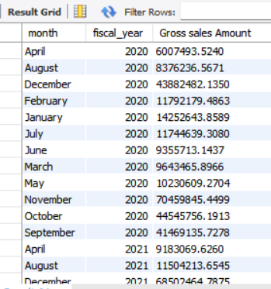
Get the complete report of the Gross sales amount for the customer “Atliq Exclusive” for each month. This analysis helps to get an idea of low and high-performing months and take strategic decisions.
SQL OUTPUT
Gross Sales for fiscal year “2020” is 281.1M
Gross Sales for fiscal year “2021” is 428.3M

Slide 14
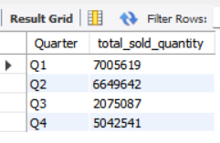
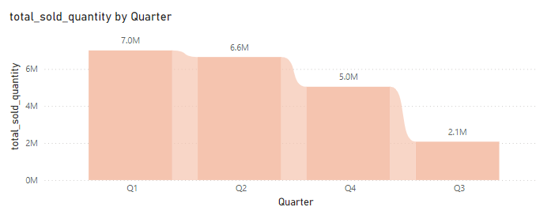
In which quarter of 2020, got the maximum total_sold_quantity?
SQL OUTPUT
Quarter1 is most sold quantity , significantly reduce the quantity of sold in FY 2020 by quarter

Slide 15
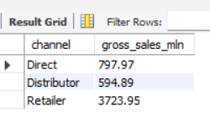
Which channel helped to bring more gross sales in the fiscal year 2021 and the percentage of contribution?
SQL OUTPUT
Retailer has more gross sales than Distributers, which is three thousand Million sales differ and having 72.77% retailer ,11.6% Distributer sales

Slide 16
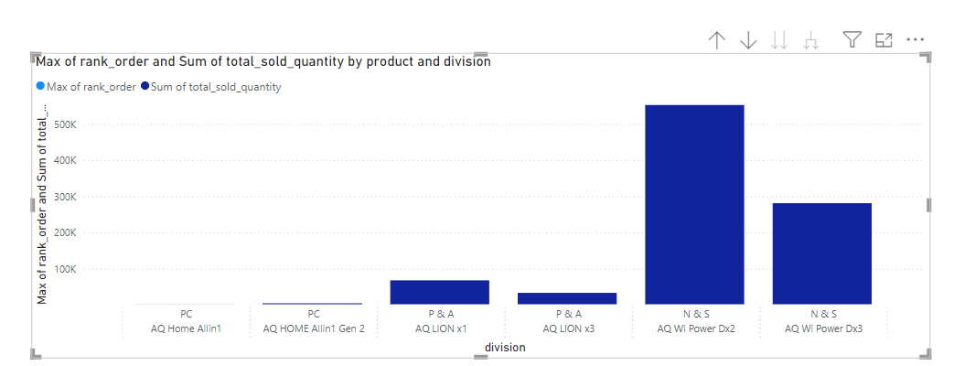
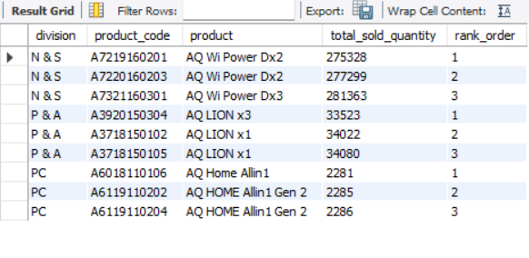
GET the Top 3 products in each division that have a high total_sold_quantity in the fiscal_year 2021?
SQL OUTPUT
In Peripherals and Accessories division highest total sold quantity is 33523 and Networking and Storage division highest sold quantity is 275328 , Personal Computer division is 2281

Slide 17
THANK YOU

